Slide 1



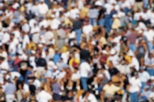
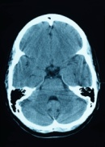


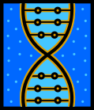





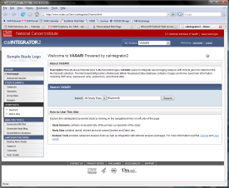
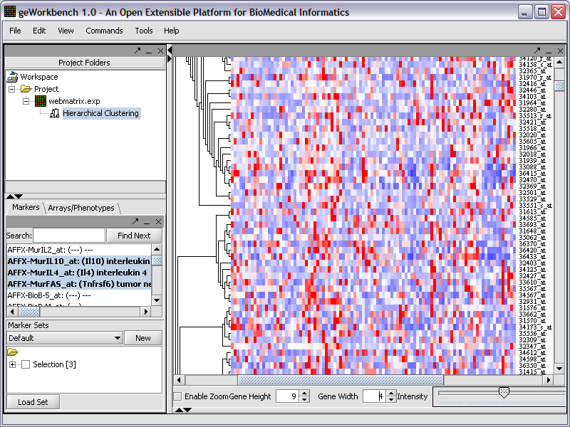
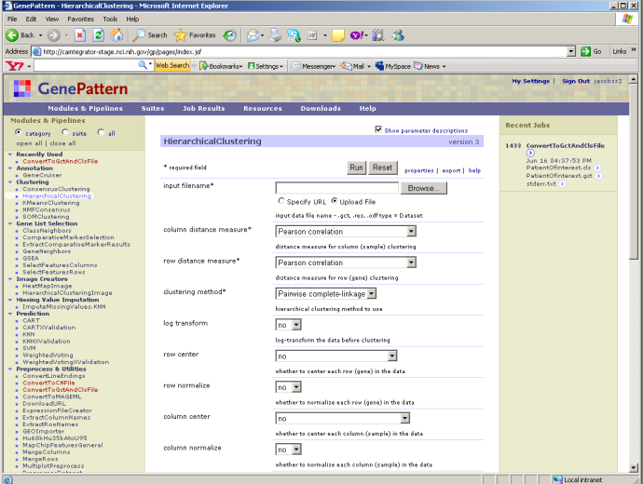
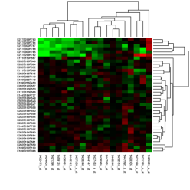
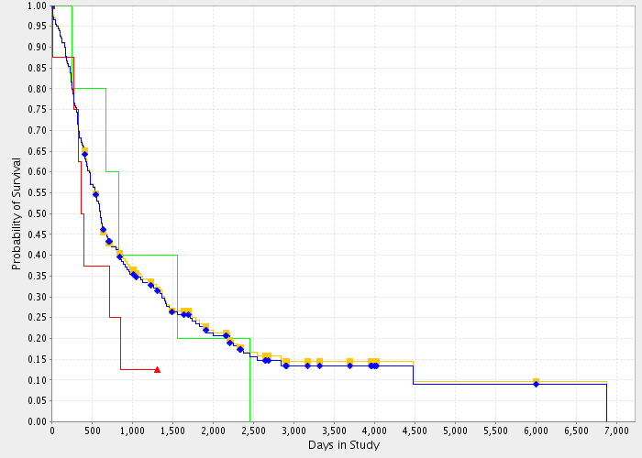
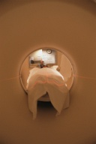
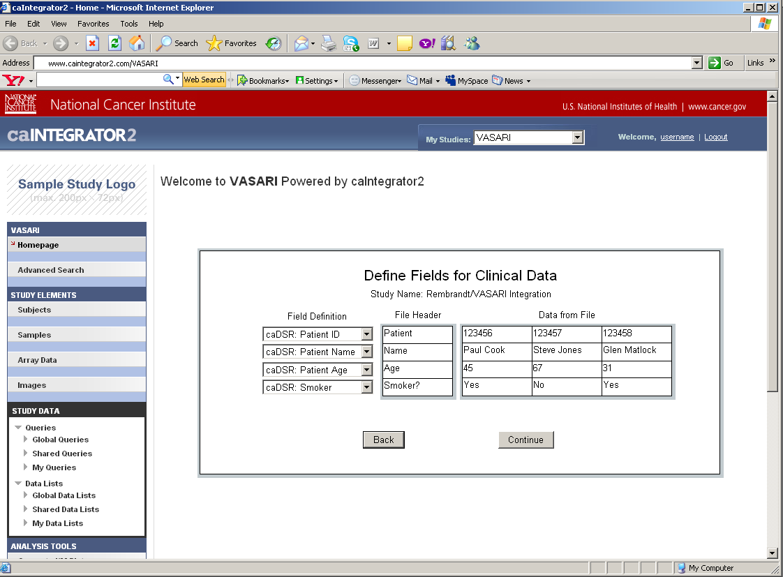
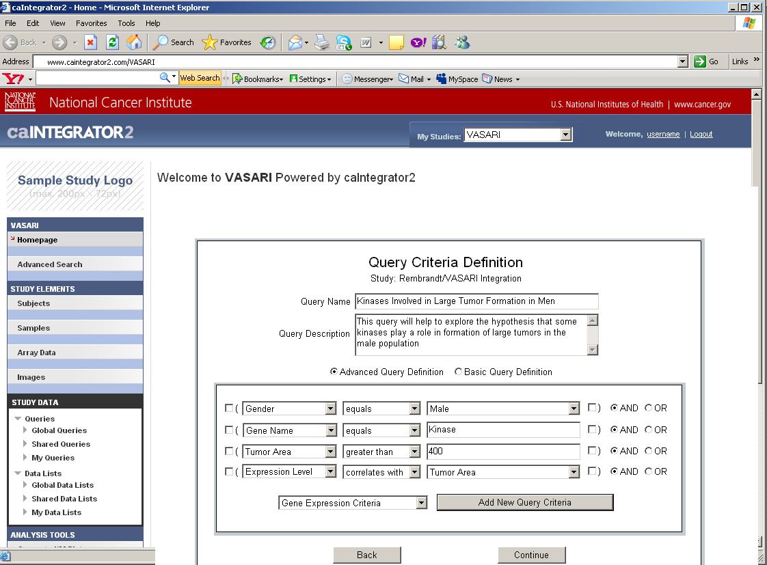
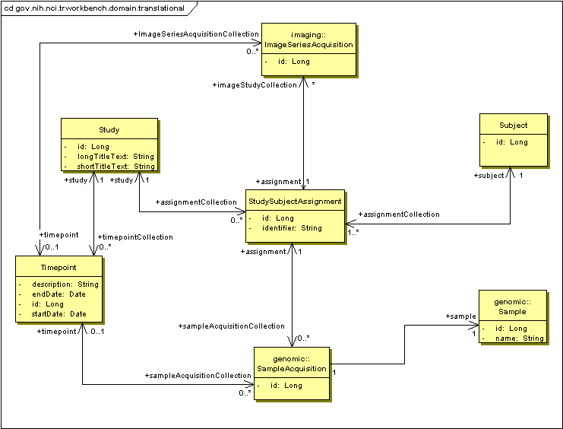
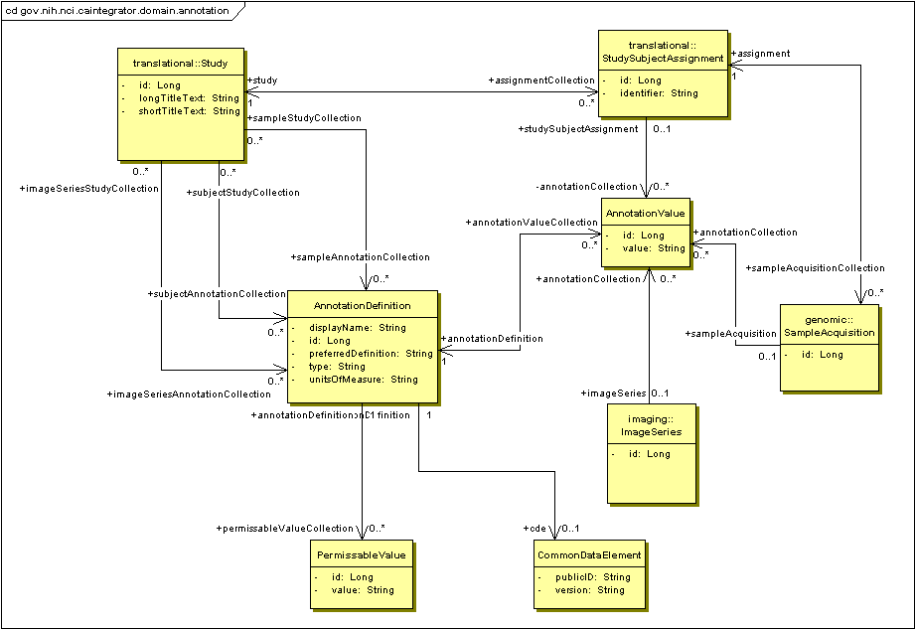

VASARI: Integration of Neuroimaging Analysis with Clinical-Genomic Data in Rembrandt
Will FitzHugh⁵,Shine Jacob⁵,Eric Tavela⁵,Himanso Sahni⁴,Huaitian Liu⁴, John Freymann⁴ , TJ Andrews⁶, Michael Holck⁶,Adam Flanders²,Daniel Rubin³,Anand Basu¹,Lori Dodd¹,Carl Jaffe¹,Subha Madhavan¹
NCI¹, Thomas Jefferson University Hospital², Stanford University Medical Center³, SAIC⁴, 5AM Solutions⁵, ScenPro⁶
Abstract
Use Cases
VASARI is the integration of Neuroimaging analysis with clinical and functional genomics data from clinical trials involving patients suffering from Gliomas in REpository for Molecular BRAin Neoplasia DaTa (REMBRANDT) repository. Vasari will provide researchers with the ability to perform ad hoc querying and reporting of Neuroimaging analysis across multiple data domains, such as Gene Expression, Chromosomal aberrations, and Clinical data. Via Rembrandt, researchers will also be able to view or download the annotated imaging data stored at the National Cancer Imaging Archive (NCIA) repository.
CTODS
(Clinical Trials Object Data System)
Clinical Data
OR
caIntegrator2
Query and Browse Study Data: Research Investigators can browse and filters lists of study objects, such as patients, image series and genes. They can also run and create queries that can produce lists of any object and associated annotation, in a specified order. Query results can be saved or exported to spreadsheets.
Clinical Annotation Spreadsheet
caArray
Description
Genomic Data
(mRNA expression, array CGH)
NCIA
(National Cancer Imaging Archive)
Image Annotation Spreadsheet
Imaging Data
Kaplan-Meier Plots
GeWorkbench
GenePattern
The caIntegrator2 framework will be used to implement VASARI. CaIntegrator2 allows Study Managers to create new studies without any new software or database development. They can define the data sources, map the data to existing datatypes, and deploy the study using a web interface.
Research Investigators can then use the tool to browse the main study objects such as patients, image series and genes. They can also create, run, and save complex queries that can be made available to other users. Users can also integrate data with external tools such as GenePattern and GeWorkbench which can be used for performing classification and clustering analysis, among others.
Patients in Study
Perform Analysis: Data from caIntegrator2 can be sent to other software packages for more sophisticated analysis. GenePattern and GeWorkbench are available for clustering and classification analysis and several other analysis tools are built in, including Kaplan-Meier survival plots.
Deploy Study: The Study Manager defines the sources of data for a new study. The data is then accessed over the Grid or uploaded from files. The Study Manager defines relationships between patients and samples so that data can be compared properly across the data sources. The Study Manager also defines mapping of uploaded annotation fields to caDSR datatypes.
Web Interface
Object Model
Focus on Interaction
Manage Queries: This page allows the Study Manager to create queries that can be shared with all researchers who have access to the study. These queries can access all fields from all data sources and complex queries can be built up from logical combinations of simpler queries. The queries can also look for correlation relationships such as genes that are up-regulated in a certain tumor type determined by imaging.
Deploy Study: This page allows the Study Manager to map each uploaded clinical data field to a caDSR datatype. The detailed datatype description, field type (number, date, yes/no, etc.) and allowable values can then be read from caDSR and used to validate the data.
Future Directions
Continued integration of images with other molecular technologies such as genomic amplification/deletion and methylation data.
Correlation of prospective and retrospective clinical data with image data to use images characteristics as surrogate markers to predict treatment responses.
Coordinate with imaging communities to improve image analysis and feature prediction methods by integrating with molecular and clinical data.
Translation Data Model: This object model shows the relationship between study subjects (patients) and the genomic and imaging data that is acquired from them. In addition, multiple timepoints can be defined for a study so that imaging and genomic data can be gathered multiple times. An example of timepoints would be ‘At Diagnosis’ and ‘After Treatment’.
Annotation Data Model: This object model shows how annotations are stored. Annotations can be associated with patients, genomic samples and image series. The Common Data Element object defines a relationship with a caDSR datatype if an appropriate one can be found.
caBIG™ Annual Meeting June 23-25, 2008, Washington DC

